Slide 1
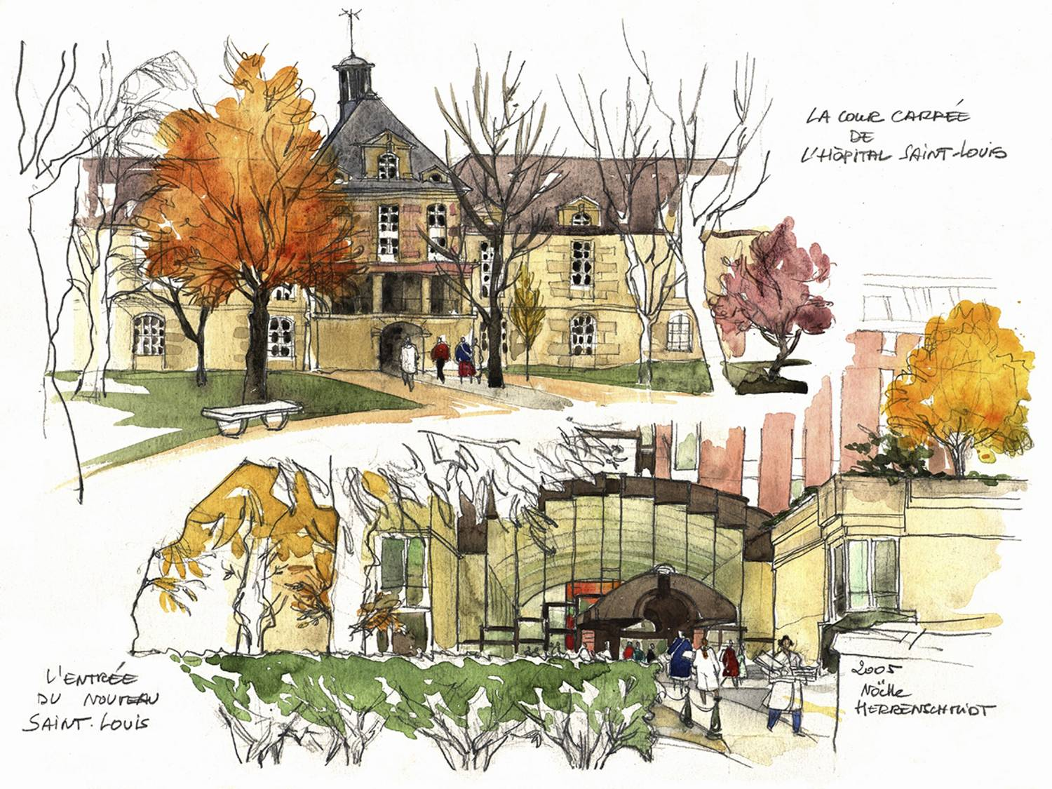



Current treatment options for AA: benefits and potential complications
Régis Peffault de Latour, MD, PhD
French reference center for aplastic anemia & PNH
French network for rare immunological & hematological disorders (MaRIH)
Severe aplastic anemia working party of EBMT (SAAWP EBMT)
Hôpital Saint-Louis, Paris, France

Slide 2


Disclosures
Expert consultant / speaker: Alexion, Amgen, Apellis, Jazz, Novartis, Pfizer, Roche & Samsung
Research grant: Alexion, Novartis & Pfizer
Notes:
Aplastic anemia is currently viewed as an autoimmune disease where auto-reactive lymphocytes recognize and destroy primitive elements of the hematopoietic compartment resulting in pancytopenia. This view is supported by evidence both in the clinic and in the laboratory. Anti-thymocyte globulin and cyclosporine is effective in most patients with severe aplastic anemia where improvement in blood counts is achieved months following immunosuppression. Oligoclonal T-cells that correlate with disease activity have been identified in patients with severe aplastic anemia suggesting an antigen driven expansion. In vitro, destruction of bone marrow progenitor cells has been shown to be induced by cytotoxic cells, mediated by TH1 related molecules, and dependent on Fas-Fas ligand. Regulatory T cells are decreased and Th17 cells increased in severe aplastic anemia patients at presentation. These observations have been confirmed in vivo in a marrow failure mouse model.

Slide 3


Patient case
Male, 17 years old
Aplastic anemia:
Hb: 4.8 g/dL; Neutrophils: 0.75 x 10⁹/L; Platelets: 11 x 10⁹/L; Reticulocytes: 35 x 10⁹/L)
Cytogenetics showed a normal male karyotype
Hypocellular bone marrow (<5%) with no dysplasia
Acquired:
Normal CBCs 10 years before
No family history
Normal physical exam
PNH positive (3%) – FA & Telomeropathy negative

Slide 4
Patient case – quiz
This patient does need more investigations
Upfront allogeneic transplantation is mandatory
The diagnosis is acquired severe aplastic anemia
A family genetic screening is necessary
Dyserythropoiesis is atypical in this situation
Rep: A, C & E

Slide 5
When should we start a treatment?
SAA
Hypocellularity (<30%) and at least 2/3 criteria:
PNN <0.5x10⁹/L
Platelets <20x10⁹/L
Reticulocytes <20x10⁹/L
VSAA
PNN <0.2x10⁹/L
Moderate
Not all criteria for SAA
PNN >0.5x10⁹/L
Transfusions?
Yes
No
Treatment
Follow-up
SAA, severe AA; VSAA, very severe AA.
Camitta BM, et al. Blood. 1976;48:63–70.

Slide 6
When should we start a treatment?
SAA
BM hypocellularity (<30%) and at least 2/3 of:
Neutrophils < 0.5 x 10⁹/L
Platelets < 20 x 10⁹/L
Reticulocytes < 20 x 10⁹/L
VSAA
SAA criteria + Neutrophils < 0.2 x 10⁹/L
Moderate AA
Does not meet criteria for SAA:
Neutrophils > 0.5 x 10⁹/L
Transfusions?
Yes
No
Treatment
Follow-up
SAA, severe AA; VSAA, very severe AA.
Camitta BM, et al. Blood. 1976;48:63–70.

Slide 7
Patient case
Male, 17 years old
Aplastic anemia:
Hb: 4.8 g/dL; Neutrophils: 0.75 x 10⁹/L; Platelets: 11 x 10⁹/L; Reticulocytes: 35 x 10⁹/L)
Cytogenetics showed a normal male karyotype
Hypocellular bone marrow (<5%) with no dysplasia
Acquired:
Normal CBCs 10 years before
No family history
Normal physical exam
PNH positive (3%) – FA & Telomeropathy negative
1 sibling available

Slide 8
Treatment (guidelines)
Idiopathic aplastic anemia
needed to be treated
HLA-identical sibling donor
and age < 40
No sibling donor
or age 40 or more
HSCT
hATG + CSA
Refractory/relapse
Marrow / Cy + ATG / CSA MTX
10/10 (8/8 matched UD)
Young (<30 years)
First year
YES: Unrelated matched BMT
NO:
Eltrombopag
Repeated IST
Alternative (mismatch BMT)

Slide 9
Sibling transplantation
Long-term
Marrow / Cy-ATG / CSA + MTX (standard) As soon as possible (<100 days)
1.0
Event | No of events | 6yr-CI (%)
Secondary cancer | 1 | 2 (0-9)
Osteonecrosis | 10 | 21 (10-36)
Cardiovascular complications | 1 | 2 (0-9)
Endocrine dysfunctions | 7 | 19 (9-31)
0.8
0.6
87,5 % (CI 95%, 78-97)
Survival probability
0.4
61 patients
Median follow-up 77 months
0.2
0.0
0
12
24
36
48
60
72
Time (months)
N. at risk
61
53
38
35
33
30
28
Saint Louis experience.
Konopacki J, et al. Haematologica. 2012;97:710-6.

Slide 10
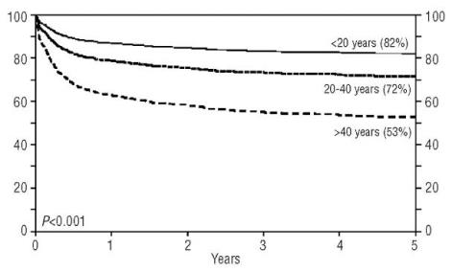
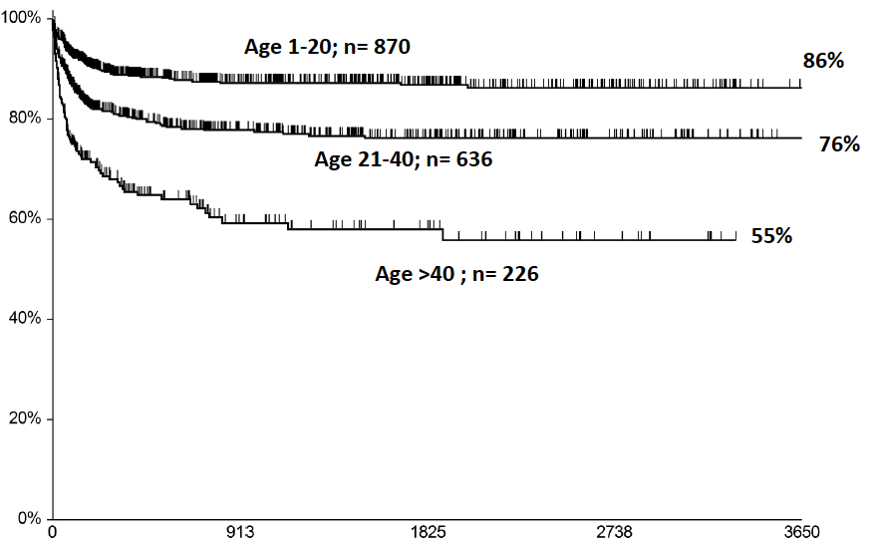

Sibling transplantation
Limitation - Age
Probability of overall survival, %
Survival
Years
Days from transplant
Bacigalupo A. Blood. 2017;129:1428-36. Gupta V, et al. Haematologica. 2010;95:2119-25.

Slide 11
Patient case
Male, 17 years old
Aplastic anemia:
Hb: 4.8 g/dL; Neutrophils: 0.75 x 10⁹/L; Platelets: 11 x 10⁹/L; Reticulocytes: 35 x 10⁹/L)
Cytogenetics showed a normal male karyotype
Hypocellular bone marrow (<5%) with no dysplasia
Acquired:
Normal CBCs 10 years before
No family history
Normal physical exam
PNH positive (3%) – FA & Telomeropathy negative
No sibling but good probability for a 10/10 unrelated donor

Slide 12
Treatment (guidelines)
Idiopathic aplastic anemia
needed to be treated
HLA-identical sibling donor
and age < 40
No sibling donor
or age 40 or more
HSCT
hATG + CSA
Refractory/relapse
Marrow / Cy + ATG / CSA MTX
10/10 (8/8 matched UD)
Young (<30 years)
First year
YES: Unrelated matched BMT
NO:
Eltrombopag
Repeated IST
Alternative (mismatch BMT)

Slide 13
Treatment (guidelines)
Idiopathic aplastic anemia
needed to be treated
HLA-identical sibling donor
and age < 40
No sibling donor
or age 40 or more
MUD up-front?
HSCT
hATG + CSA
Refractory/relapse
Marrow / Cy + ATG / CSA MTX
10/10 (8/8 matched UD)
Young (<30 years)
First year
YES: Unrelated matched BMT
NO:
Eltrombopag
Repeated IST
Alternative (mismatch BMT)

Slide 14
Patient case
Male, 17 years old
Aplastic anemia:
Hb: 4.8 g/dL; Neutrophils: 0.75 x 10⁹/L; Platelets: 11 x 10⁹/L; Reticulocytes: 35 x 10⁹/L)
Cytogenetics showed a normal male karyotype
Hypocellular bone marrow (<5%) with no dysplasia
Acquired:
Normal CBCs 10 years before
No family history
Normal physical exam
PNH positive (3%) – FA & Telomeropathy negative
No sibling
No 10/10
Only 9/10 CB or haplo donor

Slide 15
Treatment (guidelines)
Idiopathic aplastic anemia
needed to be treated
HLA-identical sibling donor
and age < 40
No sibling donor
or age 40 or more
HSCT
hATG + CSA
Refractory/relapse
Marrow / Cy + ATG / CSA MTX
10/10 (8/8 matched UD)
Young (<30 years)
First year
YES: Unrelated matched BMT
NO:
Eltrombopag
Repeated IST
Alternative (mismatch BMT)

Slide 16
How to improve immunosuppression?
Standard IST for patients with SAA/vSAA who are not eligible for HSCT is horse antithymocyte globulin (hATG) plus ciclosporin (CsA) since 30 years
Add androgens to ATG¹
No increase in response rate
Add or replace ATG with high-dose corticosteroids²
No increase in response rate; high toxicity
Replace ATG with high-dose Cy^{3,4}
Toxicity
Replace ATG with moderate-dose Cy⁵
Excessive toxicity secondary to neutropenia
Add mycophenolate mofetil to ATG/CsA⁶
No improvement in response/survival
Add sirolimus to ATG/CsA⁷
No improvement in response/survival
Add G-CSF to ATG/CsA⁸
No improvement in response/survival
1. Champlin RE, et al. Blood. 1985;66:184-8. 2. Marmont AM, et al. Prog Clin Biol Res. 1984;148:271-87. 3. Tisdale JF, et al. Lancet. 2000;356:1554-9. 4. Tisdale JF, et al. Blood. 2002;100:4668-70. 5. Scheinberg P, et al. Blood. 2014;124:2820-3. 6. Scheinberg P, et al. Br J Haematol. 2006;133:606-11. 7. Scheinberg P, et al. Haematologica. 2009;94:348-54. 8. Locasciulli A, et al. Haematologica. 2004;89:1054-61.
G-CSF, granulocyte-colony stimulating factor.

Slide 17

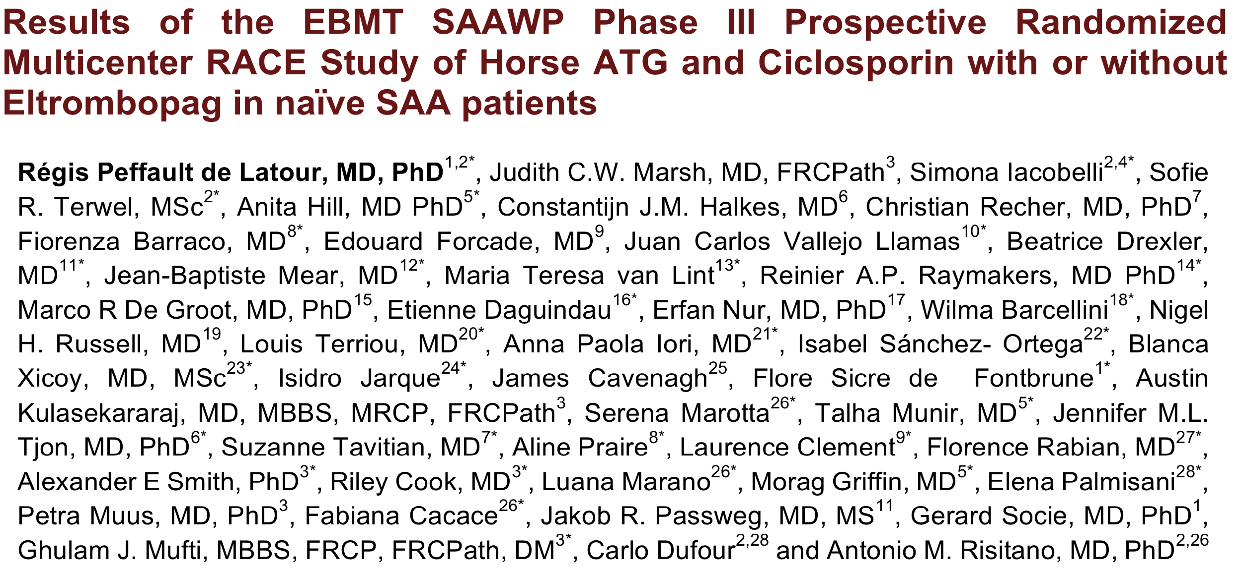

Slide 18
Race design
The RACE trial is an investigator-driven, open-label, phase 3, randomized trial comparing the combination of hATG, CsA, and eltrombopag with IST alone in patients with SAA
Treatment
Key inclusion criteria
Age ≥ 15 years
SAA or vSAA defined by
at least two of the following
ANC < 0.5 × 10⁹/L (SAA) or < 0.2 × 10⁹/L (vSAA)
Platelet count < 20 × 10⁹/L
Reticulocyte count < 60 × 10⁹/L
Hypocellular BM (cellularity < 30%) without evidence of fibrosis or malignant cells
Arm A (n = 101): IST
hATG (40 mg/kg for 4 days)
+
CsA (5 mg/kg/day)
Primary endpoint
Hematologic CR at 3 months
Key secondary endpoints
OS
Hematologic response at 6 months
Cumulative incidence of clonal evolution
Number and allele burden of somatic myeloid mutations
Randomization 1:1
Arm B (n = 96): IST + eltrombopag
hATG (40 mg/kg for 4 days)
+
CsA (5 mg/kg/day)
+
Eltrombopag (150 mg/day from Day 14 until 6 months or 3 months in case of early CR)
Central laboratory King’s college, London
Stratification based on disease severity, age and center
ANC, absolute neuthrophil count; vSAA, very severe aplastic anemia.

Slide 19
RACE definitions & study design
RACE criteria for response
CR: Hb >100 g/L, neutrophils >1.0x109/L and platelets >100x109/L
PR: no longer meets SAA criteria, Transfusion independence, Hb >8gr/dL, neutrophils >0.5x109/L and platelets >20x109/L
NR: not meeting criteria for response
Clonal evolution
Acute leukemia, myelodysplastic syndrome and/or new karyotypic abnormality
Primary endpoint
To detect an increase in CR from 7% in arm A to 21% in arm B at 3m (at least 96 patients per arm)

Slide 20
Baseline characteristics
 | Arm A | Arm B | Total
No. of patients | 101 (51.3%) | 96 (48.7%) | 197 (100%)
Age (median, min-max) | 52 (15-81) | 55 (16-77) | 53 (15-81)
Age categories (n, %)
<18 y | 7 (6.9%) | 2 (2.1%) | 9 (4.6%)
18-<40 | 29 (28.7%) | 27 (28.1%) | 56 (28.4%)
40-<65 | 43 (42.6%) | 43 (44.8%) | 86 (43.7%)
>65 | 22 (21.8) | 24 (25.0%) | 46 (23.4%)
Sex (n, %)
Male | 52 (51.5%) | 56 (58.3%) | 108 (54.8%)
Female | 49 (48.5%) | 40 (41.7%) | 89 (45.2%)
Severity of AA (n, %)
SAA | 67 (66.3%) | 62 (64.6%) | 129 (65.5%)
vSAA | 34 (33.7%) | 34 (35.4%) | 68 (34.5%)
PNH granulocytes >1.0% (n, %) | 44 (44.9%) | 33 (35.5%) | 77 (40.3%)

Slide 21
Hematological response
The RACE study was powered to detect an increase in CR from 7% in arm A to 21% in arm B at 3 months (primary endpoint).
CR at 3 months*:
Arm A: 9.9% & Arm B: 21.9%
Pooled Odds Ratio 3.2, p=0.012
OR at 6 months (preliminary analysis n=181)*:
Arm A: 44.8% & Arm B: 71.8%
Pooled Odds Ratio: 3.7
*Prior transplantation, clonal evolution or death were considered as no response at 3 and 6m
Notes:
To elaborate more why endpoint is selected for CR at 3M in RACE study.

Slide 22
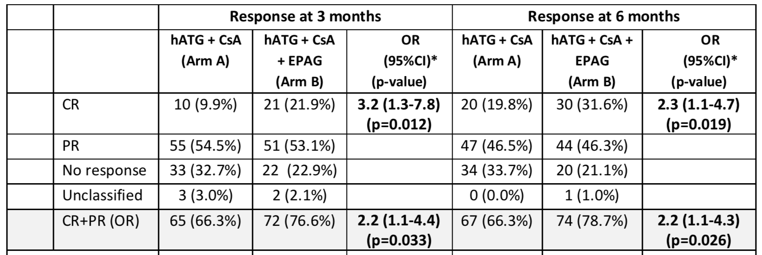
Hematological response (NIH criteria)
NIH criteria = PR: transfusion independency not needed
Cohort 2 NIH (EPAG day 14 > 3 months): CR 26%, PR 61%, OR 87% at 6 months

Slide 23
Safety
 | Arm A | Arm B | Total
Serious Adverse Events* | 135 | 145 | 280
Fatal cases | 14 | 8 | 22
Patients coming off study treatment prematurely requiring second line HSCT | 13 | 11 | 24
Pregnancy | 3 | 1 | 4
*Events are classified per SOC (system organ class) according to the CTCAE (Common Terminology Criteria for Adverse Events (US National Cancer Institute of the National Institutes of Health).

Slide 24
Treatment (guidelines)
Idiopathic aplastic anemia
needed to be treated
HLA-identical sibling donor
and age < 40
No sibling donor
or age 40 or more
hATG+CSA+Eltrombopag
HSCT
hATG + CSA
Refractory/relapse
Marrow / Cy + ATG / CSA MTX
10/10 (8/8 matched UD)
Young (<30 years)
First year
YES: Unrelated matched BMT
NO:
Eltrombopag
Repeated IST
Alternative (mismatch BMT)

Slide 25
Patient case
Male, 17 years old
Aplastic anemia:
Hb: 4.8 g/dL; Neutrophils: 0.75 x 10⁹/L; Platelets: 11 x 10⁹/L; Reticulocytes: 35 x 10⁹/L)
Cytogenetics showed a normal male karyotype
Hypocellular bone marrow (<5%) with no dysplasia
Acquired:
Normal CBCs 10 years before
No family history
Normal physical exam
PNH positive (3%) – FA & Telomeropathy negative
Refractory at 6 months …

Slide 26
Patient case – quiz
This patient require a marrow aspiration with Karyotype
An inherited disorder should be search again
A second course of immunosuppression is recommended
Cord blood transplantation is an option
Normal Karyotype with somatic cancer gene mutations is an indication for transplantation
Rep: A, B & D

Slide 27
Patient case
Male, 17 years old
Aplastic anemia:
Hb: 4.8 g/dL; Neutrophils: 0.75 x 10⁹/L; Platelets: 11 x 10⁹/L; Reticulocytes: 35 x 10⁹/L)
Cytogenetics showed a normal male karyotype
Hypocellular bone marrow (<5%) with no dysplasia
Acquired:
Normal CBCs 10 years before
No family history
Normal physical exam
PNH positive (3%) – FA & Telomeropathy negative
Refractory at 6 months …
Inherited disorders?
Clonal evolution?

Slide 28
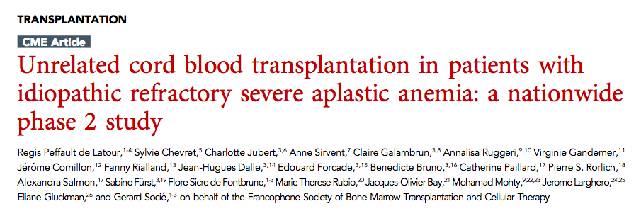


Cord Blood transplantation
60 day-CumI of neutrophil engraftment of 88.5% with full chimerism for all of them (23/26).
100 day-CumI of grade II-IV acute GVHD was 40% (95% CI, 20-60) (8 grade II; 0 grade III; 2 grade IV)
1-year CumI of cGVHD at 26% (95% CI, 6-46) (severe cGvHD in 2 pts).
3-years overall survival at 82%
Peffault de Latour et al, Blood 2018

Slide 29
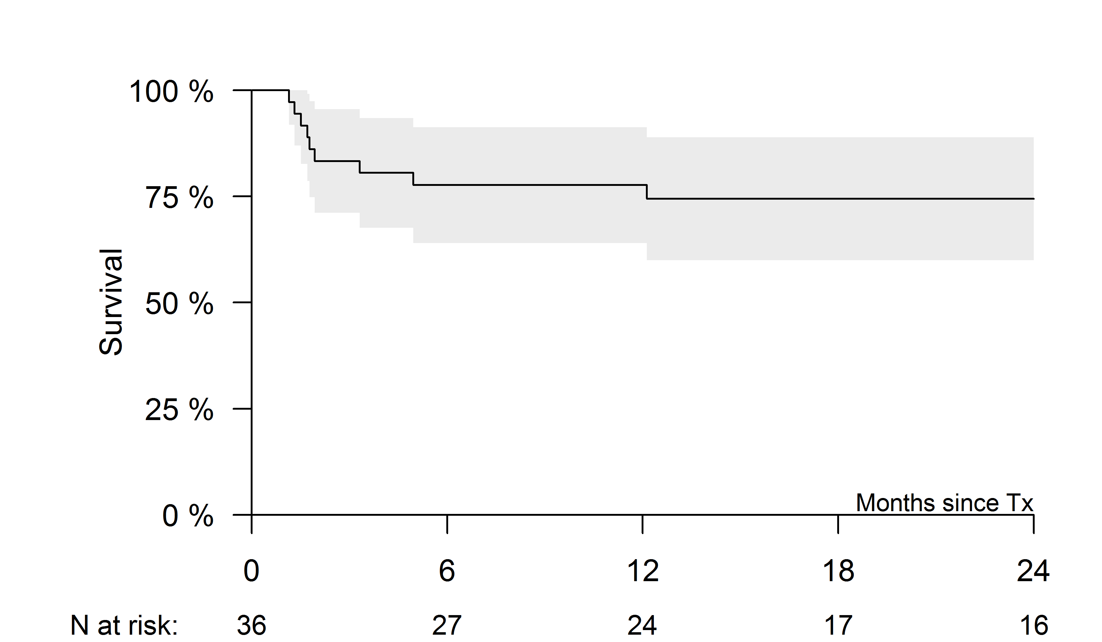
Haplo-identical transplantation (Post-Cy)
36 patients (32 with acquired SAA and 4 with IBMF)
Causes of death:
– IBMF (2/4):
1 infection
1 GvHD
– Acquired (7/32):
5 infections
2 other HSCT-related
OS 74% at 2 years

Slide 30
Conclusion
First line treatment:
MRD = choice treatment 1st line for patients of 40 years old or less
MUD 1st line is still experimental (only pediatric)
hATG+CSA+Eltrombopag for the others
Refractory patients:
MUD for patients with refractory AA of 30 years old or less is standard of care
Alternative BMT mainly for young patients (20 year or less)
Eltrombopag for the others (if no already used first line)

Slide 31

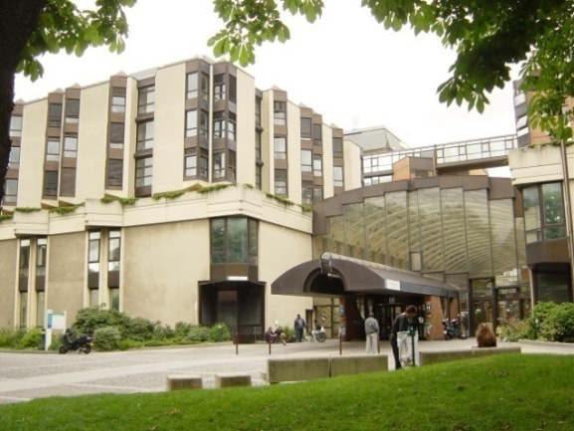

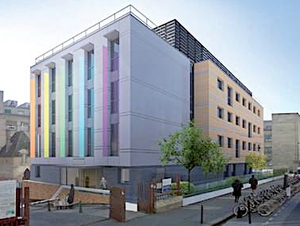



Thank you!
The French Reference Center for aplastic anemia and PNH in Paris
Saint-Louis Hospital Robert Debré Hospital Institute of Hematology, IUH St-Louis
F Sicre, T Leblanc, JH Dalle, A Baruchel, G Socié,
N Vasquez, W. Cuccuini, J Soulier (Fanconi team),
C Kannengiesser, E Lainey, L Da Costa (Telomeres team)

